Slide 1

CRIMINAL IDENTIFICATION SYSTEM USING 2D FACE RECOGNITION
Name of student s Ex. No.
1 Sai Kalyan Ayyagari
2. Bhadke Sagar Ramesh
3. Kanade Rohit Parshuram
4. Ingle Apurva Ajay
Guided by - Prof. Vina M Lomte
Computer Engineering Department
RMDSSOE, Warje

Slide 2
Introduction
Criminal identification is the task of identifying an already detected object as a known or unknown face.
Often the problem of criminal identification is confused with the problem of face detection. On the other hand is to decide if the “face” is someone known, or unknown, using for this purpose a database of faces in order to validate this input face.
This project main objective is to create an efficient architecture for criminal identification.
Dept. of Computer Engineering, RMDSSOE

Slide 3
Motivation
In the modern world, security is one of the main concerns.
There is significant rise of threats to the society with increasing rate of crimes and terrorist activities.
Even have many ways of identifying a person, Finger print recognition, voice recognition, Iris and voice recognition are the approaches of biometric identification.
It also useful in footages taken by surveillance and application.
This project is aimed to identify the criminal faces.

Slide 4
Project Scope
In this project, an automated facial recognition system for criminal database is proposed.
This system will be able to detect face and recognize face automatically. This will help the law enforcements to detect or recognize suspect of the case if no thumbprint present on the scene
The main goal of our project is to show matched faces in input images and this type of application can be useful in security.
Dept. of Computer Engineering, RMDSSOE

Slide 5
Literature Survey
No. | Paper Name | Year | Methodology | Conclusion
1 | Detection of facial components based on SVM classification and invariant feature | 2018 | Support Vector Machines (SVM) has been adapted | Succeeds in locating facial features in the facial region exactly
2 | Comparison of Three Face Recognition | 2019 | Principal Component Analysis (PCA), Linear Discriminate Analysis (LDA), and Elastic Bunch Graph Matching (EBGM | Performance benchmarking are compared for each of the algorithms in terms of recognition accuracy, compute additional cost, and recognition tolerance.
3 | A Fast Detection Model for Omnidirectional Faces | 2018 | Technique of HSI based skin detection combined with eye-core detection | Detection accuracy was 95% proved

Slide 6
Literature Survey
No | Paper Name | Year | Methodology | Conclusion
4 | Face Recognition Implementation for Client Server Mobile Application using PCA | 2017 | Client – server model and GPG infrastructure | Detection accuracy was improved
5 | Ensemble Feature Selection in Face Recognition ICMLA 2012 Challenge | 2018 | Filter-based feature selection | Achieve very high accuracy, 99% distinguish human faces

Slide 7
Literature Survey
No | Paper Name | Year | Methodology | Conclusion
6 | AUTOMATED CRIMINAL IDENTIFICATION BY FACE RECOGNITION USING OPEN COMPUTER VISION CLASSIFIERS | 2019 | Computer Vision Classifier | This paper presents a real time face recognition using a automated surveillance camera. The proposed system consists of 4 steps, including (1)training of real time images (2)face detection using Haar-classifier (3) comparison of trained real time images with images from the surveillance camera (4)result based on the comparison.
7 | Face recognition for criminal identification | 2017 | PCA Based | This system will be able to detect face and recognize face automatically.

Slide 8
Problems Identified in the Existing work
In practice, identification of criminal is done through thumbprint identification. It.is based on pattern recognition where the arches, loops and whorls of the fingerprint ridges are compared with stored data
However, this type of identification is constrained(NA Ilaj) as most of criminal nowadays getting cleverer not to leave their thumbprint on the scene. With the advent of security technology, cameras especially CCTV(closed-circuit television) have been installed in many public and private areas to provide surveillance activities
The footage of the CCTV can be used to identify suspects on scene. However, because of limited software developed to automatically detect the similarity between photo in the footage and recorded photo of criminals, the law enforce thumbprint identification.
Dept. of Computer Engineering, RMDSSOE

Slide 9
Objectives
To learn & understand python programming language.
To learn & understand MySQL.
To learn ,understand and implement windows application using python.
To detect and identify criminals using facial recognition.
Dept. of Computer Engineering, RMDSSOE

Slide 10
Problem statement
To develop a windows based prototype model using python for criminal identification using 2d face recognition using image processing.

Slide 11
Propose System
Proposed system will be a windows based application which will be developed using python programming language.
First system will be trained to identify criminals.
Laptop webcam will be used to focus and capture the criminals.
Python & OpenCV will be used at back end.
Database used to store information will be MySQL.

Slide 12
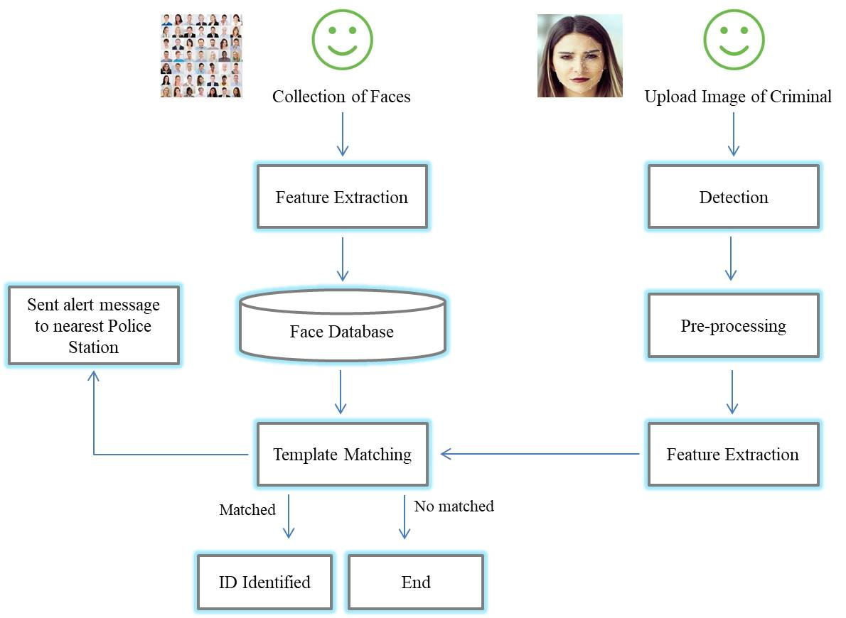
System Architecture
feature extraction is the process of extracting face component features like eyes, nose, mouth, etc from human face image

Slide 13
Project Modules
Front End
Back End
Database

Slide 14
Project Modules
Front End:
Front End will be developed using html technology.
Back End:
Back will be developed using Python and OpenCV.
computer vision tasks. It is aOpenCV is a great tool for image processing and performing n open-source library that can be used to perform tasks like face detection, objection tracking, landmark detection, and much more. It supports multiple languages including python, java C++
Back end contains preprocessing, feature extraction and classification.
Database:
Database used to store user information will be MySQL.

Slide 15
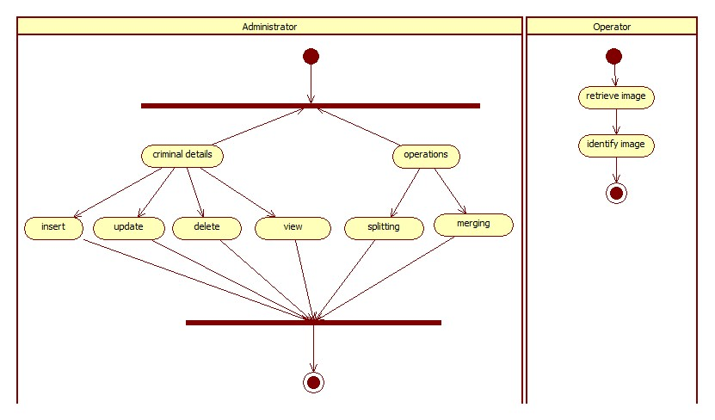
Activity Diagram

Slide 16
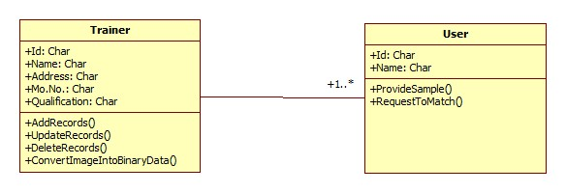
Class Diagram

Slide 17
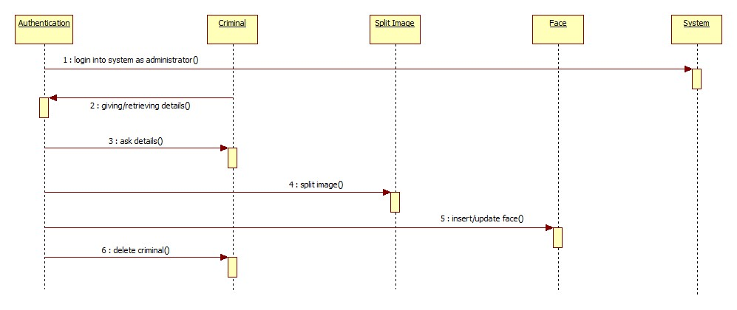
Sequence Diagram

Slide 18
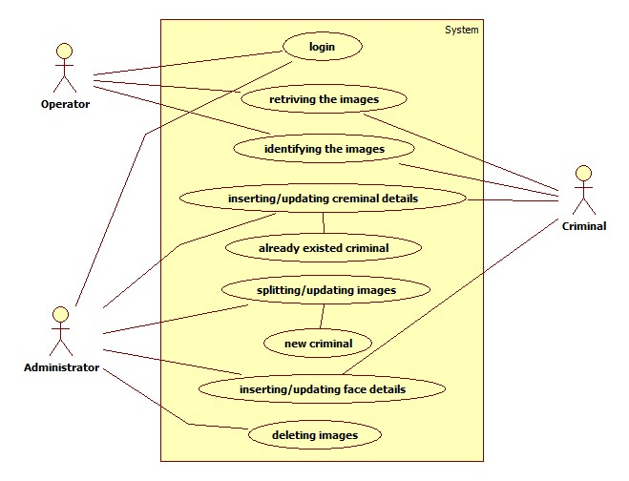
Usecase Diagram

Slide 19
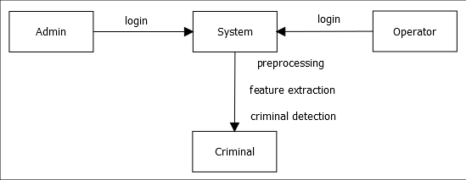
DFD Level 0 Diagram

Slide 20
Algorithm 1- Face Recognition
Eigenfaces Face Recognizer-
This algorithm considers the fact that not all parts of a face are equally important or useful for face recognition.
Fisherfaces Face Recognizer-
This algorithm is an improved version of the last one. As we just saw, EigenFaces looks at all the training faces of all the people at once and finds principal components from all of them combined.
Since EigenFaces also finds illumination as a useful component, it will find this variation very relevant for face recognition and may discard the features of the other people's faces, considering them less useful.

Slide 21
Continue…
In the end, the variance that EigenFaces has extracted represents just one individual's facial features
There are three easy steps to computer coding facial recognition-
1) Data Gathering: Gather face data (face images in this case) of the persons you want to identify.
2) Train the Recognizer: Feed that face data and respective names of each face to the recognizer so that it can learn.
3) Recognition: Feed new faces of that people and see if the face recognizer you just trained recognizes them.

Slide 22
Algorithm 2- K-mean Clustering
Input: K- the number of clusters
Dataset: a data set containing n objects
Output: A set of k clusters
Step 1: Randomly select k data objects from dataset D as initial cluster centers.
Step 2: Repeat
Step 3: Calculate the distance between each data object di (1 <= i <= n) and all k cluster centers cj (1 <= j <= k) and assign data object di to the nearest cluster.
Step 4: For each cluster j (1<=j<=k), recalculate the cluster center.

Slide 23
Continue…
Step 5: Until no changing in the center of clusters.
The computational complexity of the algorithm is O(nkt)
Where, n: the total number of objects
k: the number of clusters
t: the number of iterations

Slide 24
Mathematical Model
S be Closed system defined as, S = Ip, Op, Ss, Su, Fi, A
To select the input from the system and perform various actions from the set of actions A so that Su state can be attained.
S=Ip,Op,Ss,Su,Fi,A
Where,
IP1=Username, Password, Face
Set of actions=A=F1,F2,F3
Where
F1= Preprocessing
F2= Feature Extraction
F3= Classification as a criminal name.

Slide 25
Mathematical Model
S=Set of users
Ss=rest state, capturing face, processing, classification
Su- success state is successful analysis
Fi- failure state
Objects:
1) Input1: Ip1 = Username, Password
2) Input2 : Ip2= Face
1) Output1 : Op1 = Classification as criminal
2) Output2 : Op2 = crime

Slide 26
Feasibility Study
Languages used are
Python
MySQL
which all are open source.
From these it’s clear that the project is financially feasible

Slide 27
Feasibility Study
In this project the technologies to be used are as follows:
Python
MySQL
Diagram drawing tools like star uml, draw.io
Each of the technologies are freely available and the technical skills required are manageable.
From these it’s clear that the project is technically feasible

Slide 28
Feasibility Study
Resource feasibility
Resources that are required for the project includes,
Programming device (Laptop)
Programming tools (freely available)
Programming individuals
Hardware is not required(External)
So it’s clear that the project has the required resource feasibility.

Slide 29
COCOMO MODEL
The Basic COCOMO equations is as below:
E = ab KLOC bb
D = cb E db
Where, E is the effort applied in person-months.
D is the development time in chronological months.
KLOC is the estimated number of delivered lines of code for the project (express in thousands).

Slide 30
COCOMO MODEL
The coefficients a_{b} and c_{b} and the exponents b_{b} and d_{b} are given in Table
Software Project | a_{b} | b_{b} | c_{b} | d_{b}
organic | 2.4 | 1.05 | 2.5 | 0.38
Semi-detached | 3.0 | 1.12 | 2.5 | 0.35
embedded | 3.6 | 1.20 | 2.5 | 0.32

Slide 31
COCOMO MODEL
Our proposed system is purely software oriented and the no of lines of codes will be approximately 2000,
E=2.4*2^1.05=
D=2.5*E^0.38=

Slide 32
Risk Analysis
File sizes and the complete project size will not exceed 200MB.
Being a 31 weeks project, the project will have several deadlines and deliverables that can be scheduled successively.
Depending on the coding and designing efforts, the deadlines are quite reasonable.
So this project is feasible and risk free.

Slide 33
Advantages
Security levels will be significantly improved.
High accuracy allows avoiding false identification.
Fully automated.

Slide 34
Expected Result/Outcome
Criminal Face recognition.
Criminal Name
Crimes

Slide 35
System Requirement
Software Requirement
Operating System: Microsoft Windows 7 or Above
Language: Python
Database: MySQL
Hardware Requirement
Processor: Intel Core I3 or Higher
RAM: 4GB or Higher
Hard Disk: 100GB (min)
Web Camera

Slide 36
Applications
Application- Benefits of the project to the society:
Identification of Criminals
ATM and bank video surveillance
Prevent fraud voters
Find a thief or terrorist in stored video database from surveillance

Slide 37
Conclusion
We have proposed criminal identification using Python & openCV.
The system aims to find solutions for a robust method for criminal identification from live videos, reducing the time requirements for face recognition .
This system provides better approach to detect criminal.

Slide 38
Future Scope
In future we introduce a new face recognition technique to accomplish a system to handle video based images under variety of pose and illumination conditions.
And also we make use of PCA, FLDA technique to obtain virtual frontal face for Dimensionality reduction and Presentation respectively.
LLR technique to obtain virtual frontal face and we appoint DCT for illumination normalization.

Slide 39
References
[1] Yang Yang, Zheng-Jun Zha, Heng Tao Shen and Tat-Seng Chua, “Robust Semantic Video Indexing by Harvesting Web Images”, S. Li et al. (Eds.): MMM.
[2] Chih-Chin Lai; Ying-Chuan Chen, “A User-Oriented Image Retrieval System Based on Interactive Genetic Algorithm”, IEEE Transactions on Instrumentation and Measurement, Volume: 60 , Issue: 10,.
[3] Beecks, C.; Uysal, M.S.; Seidl, T., “A comparative study of similarity measures for content-based multimedia retrieval”, IEEE International Conference on Multimedia and Expo (ICME),.
[4] Lin Lin; Chao Chen; Mei-Ling Shyu; Shu-ChingChen “Weighted Subspace Filtering and Ranking Algorithms for Video Concept Retrieval”, IEEE Multimedia, Volume: 18 , Issue: 3,.
[5] Sujatha, S. S., Survey Paper on Various Methods in Content Based Information Retrieval, International Journal Of Research In Engineering & Technology,.

